Slide 1
USA Business Trip June 2012
Torbjörn and Michael
At
Stranahans Distillery - Denver
by
Finn Knudsen

Slide 2
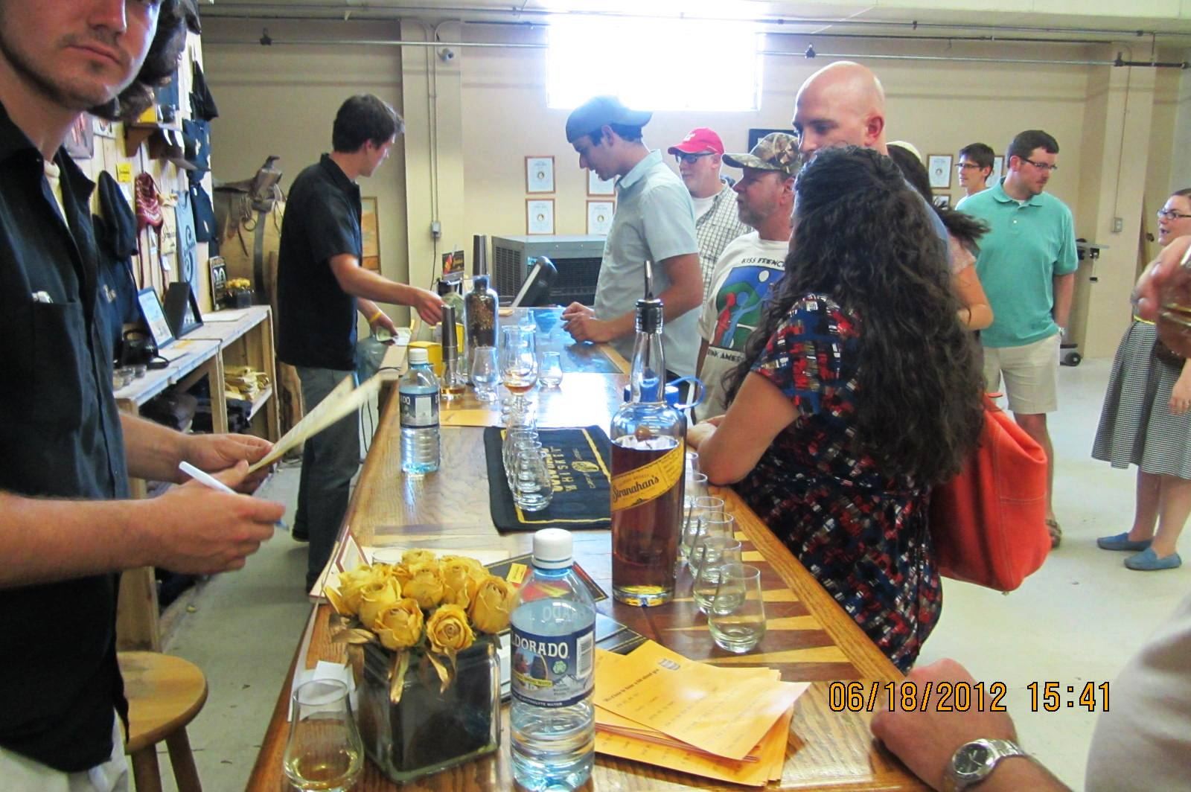
2012-06-18 - At Stranahans Distillery - Denver (11)

Slide 3
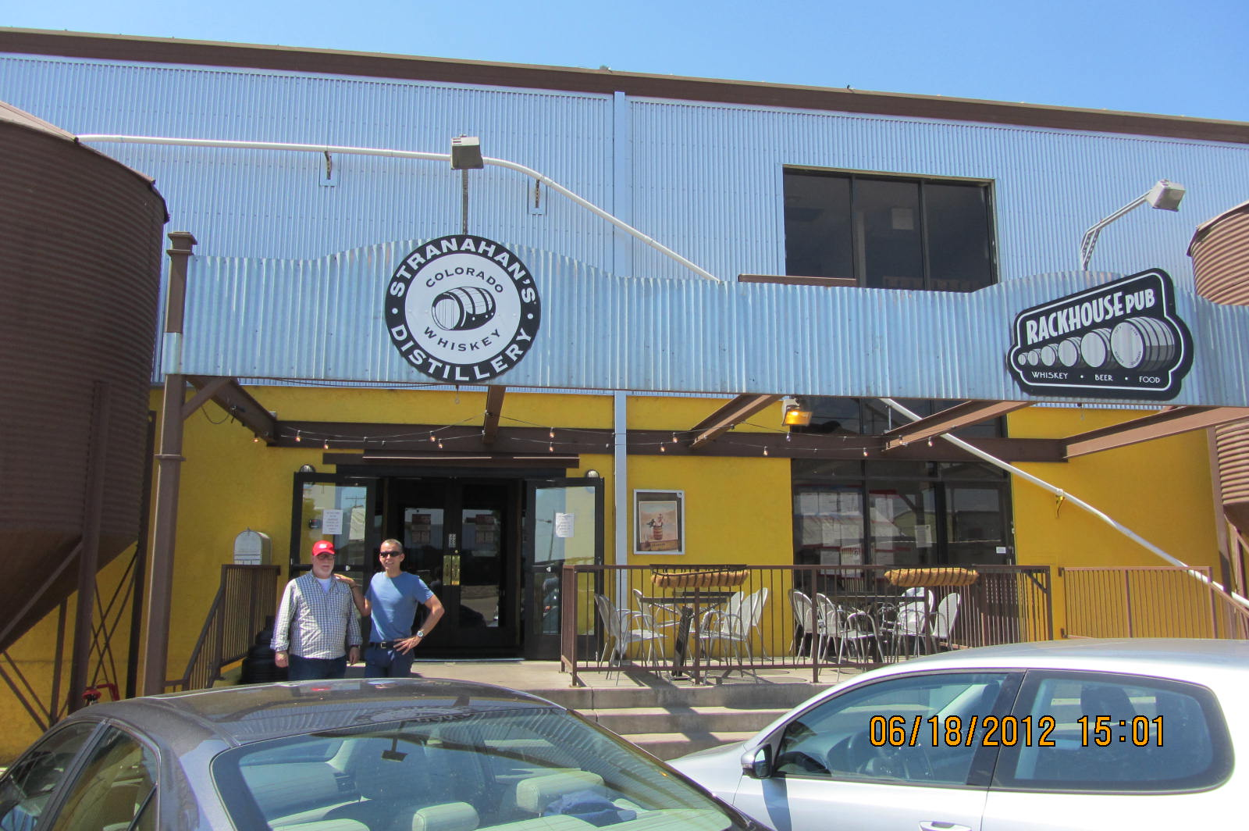
2012-06-18 - At Stranahans Distillery - Denver

Slide 4
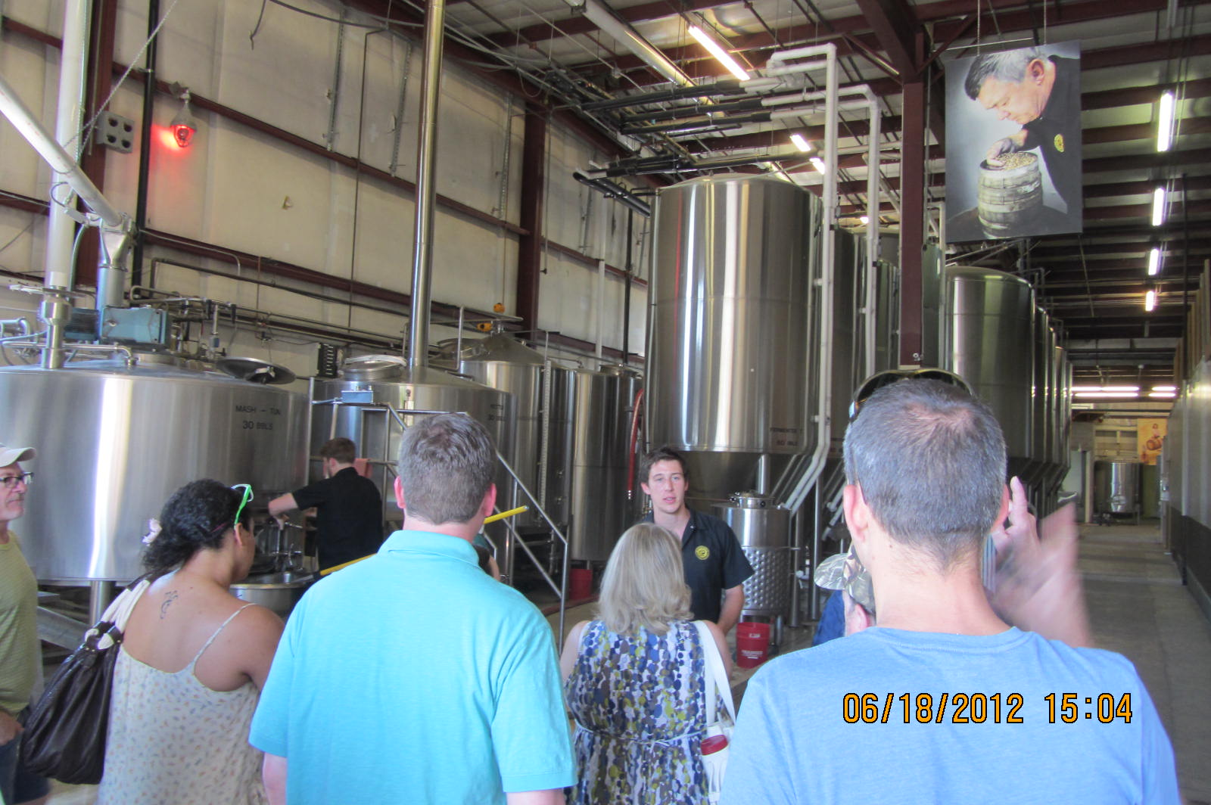
2012-06-18 - At Stranahans Distillery - Denver (1)

Slide 5
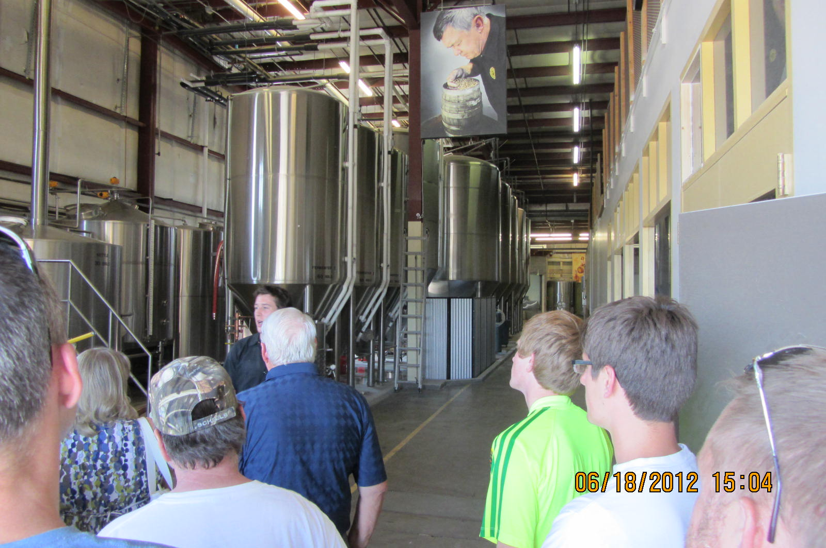
2012-06-18 - At Stranahans Distillery - Denver (2)

Slide 6
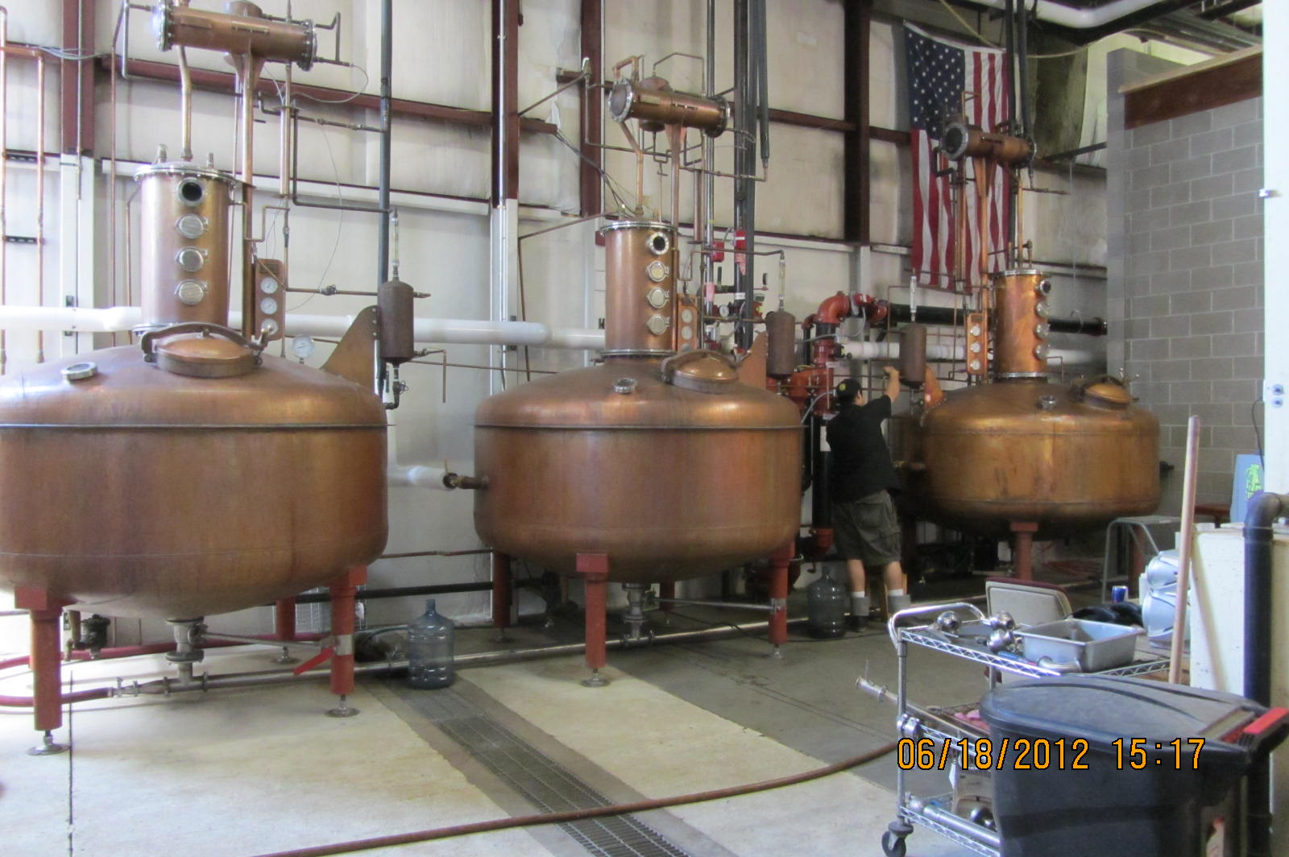
2012-06-18 - At Stranahans Distillery - Denver (3)

Slide 7
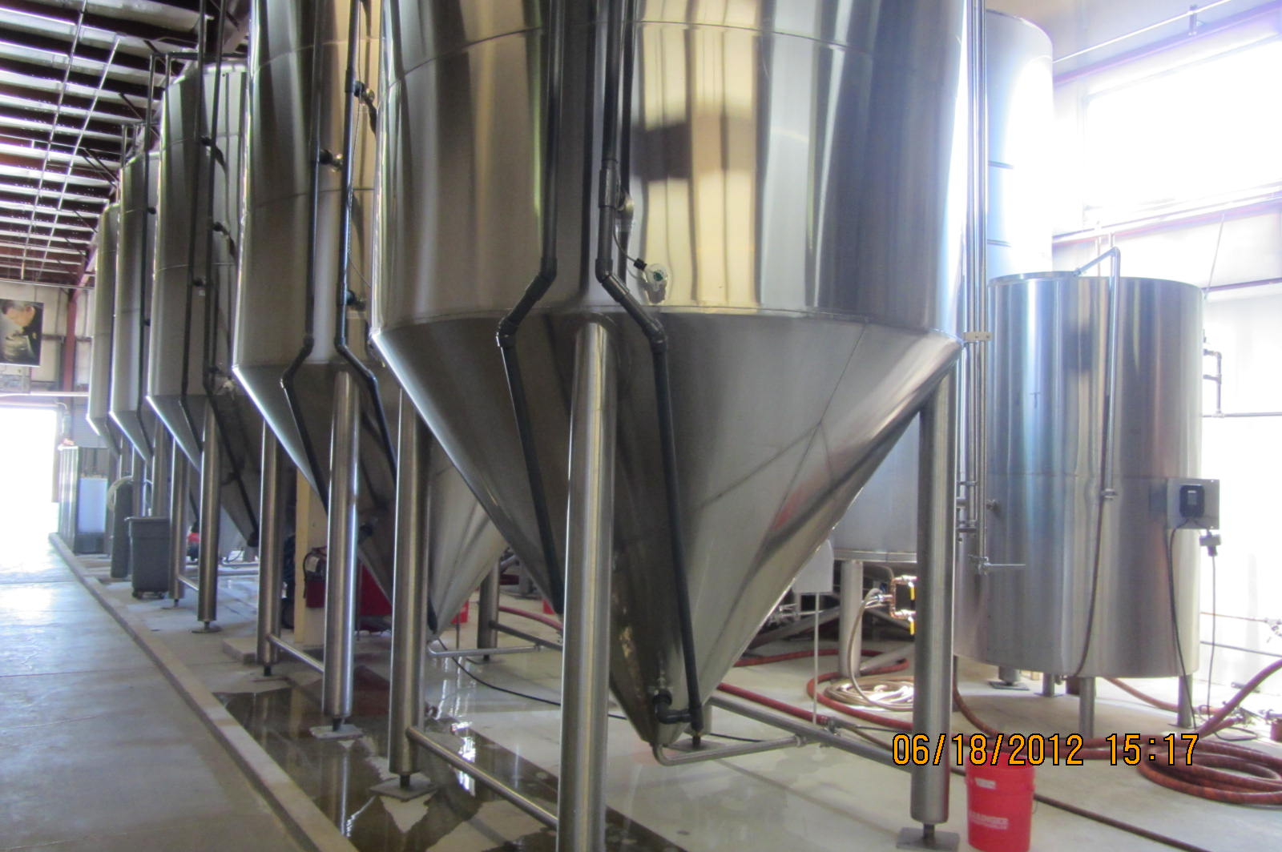
2012-06-18 - At Stranahans Distillery - Denver (4)

Slide 8
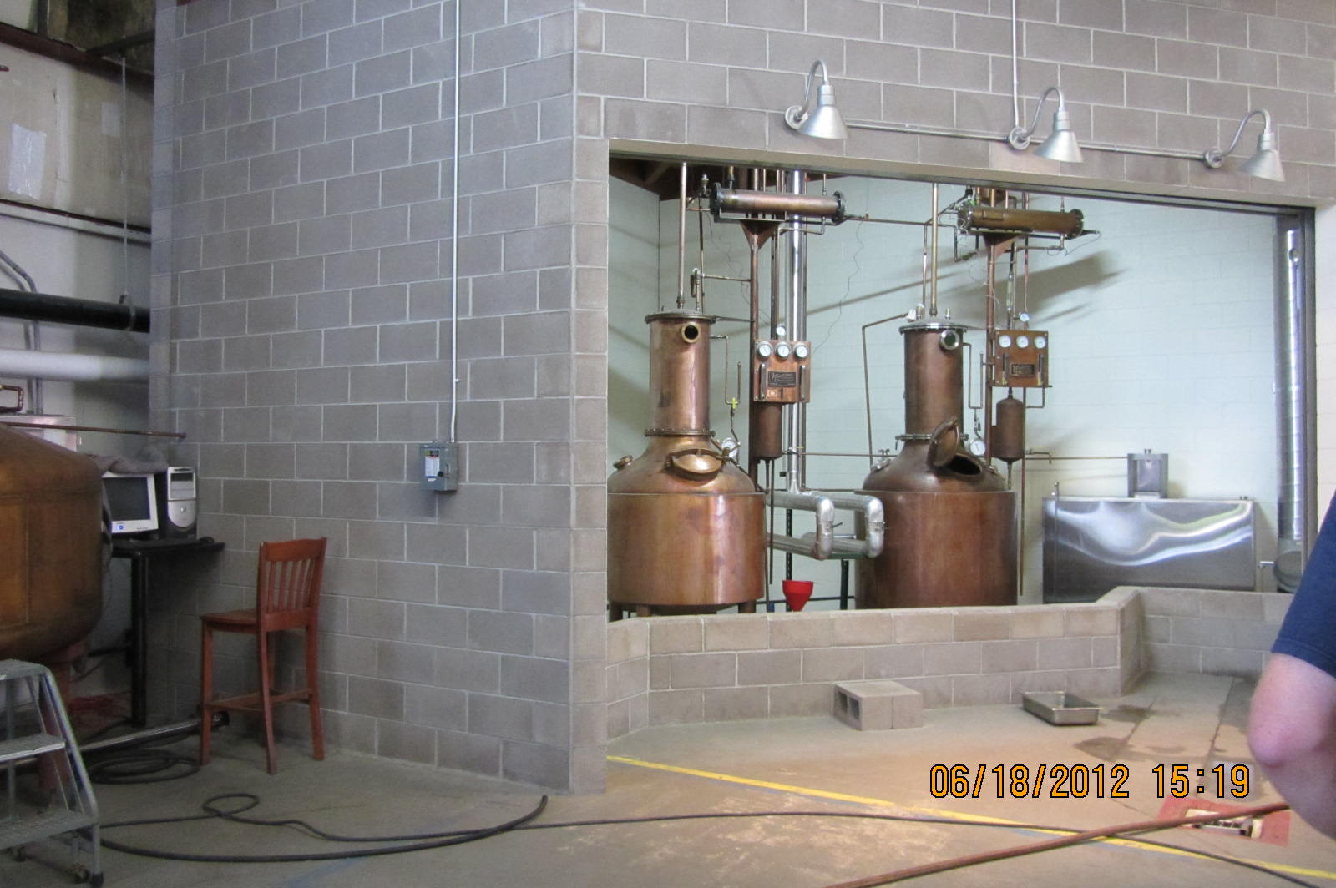
2012-06-18 - At Stranahans Distillery - Denver (5)

Slide 9
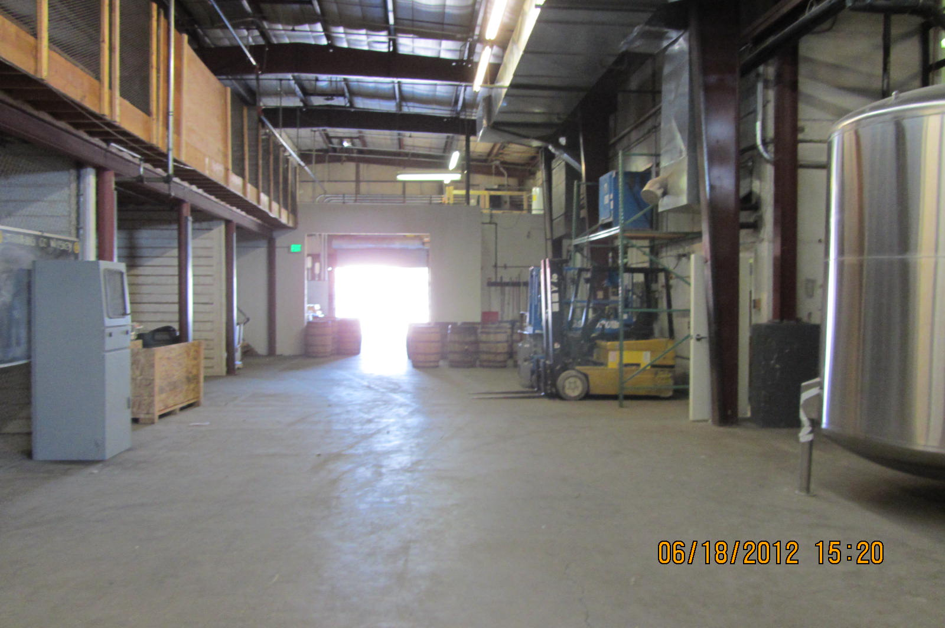
2012-06-18 - At Stranahans Distillery - Denver (6)

Slide 10
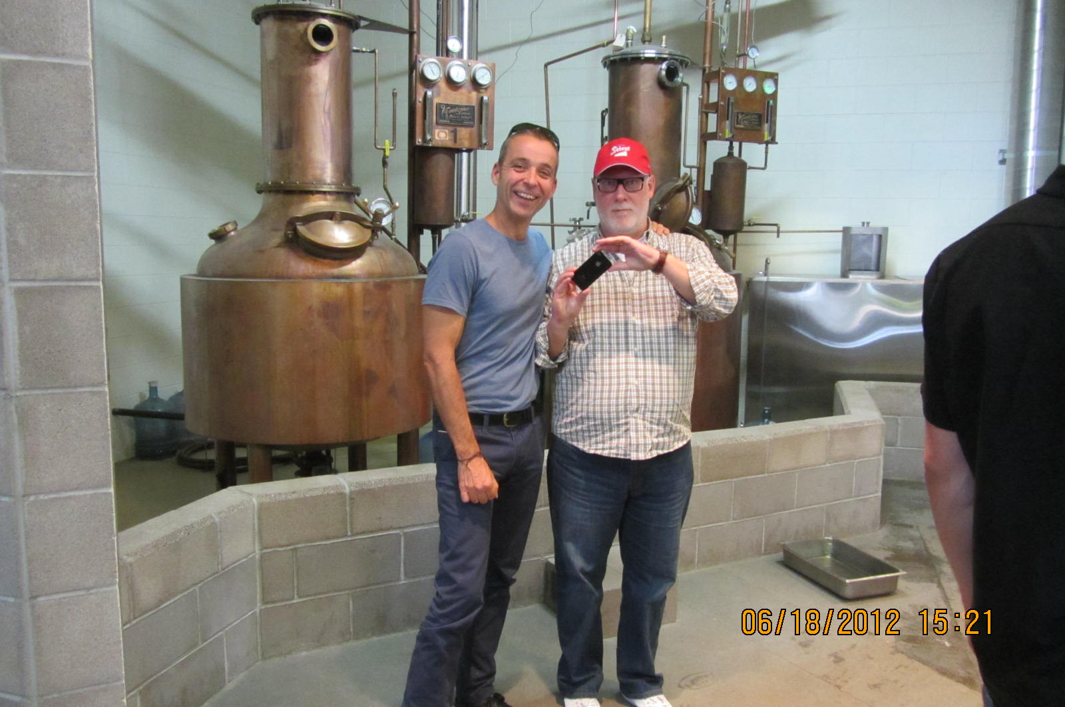
2012-06-18 - At Stranahans Distillery - Denver (7)

Slide 11
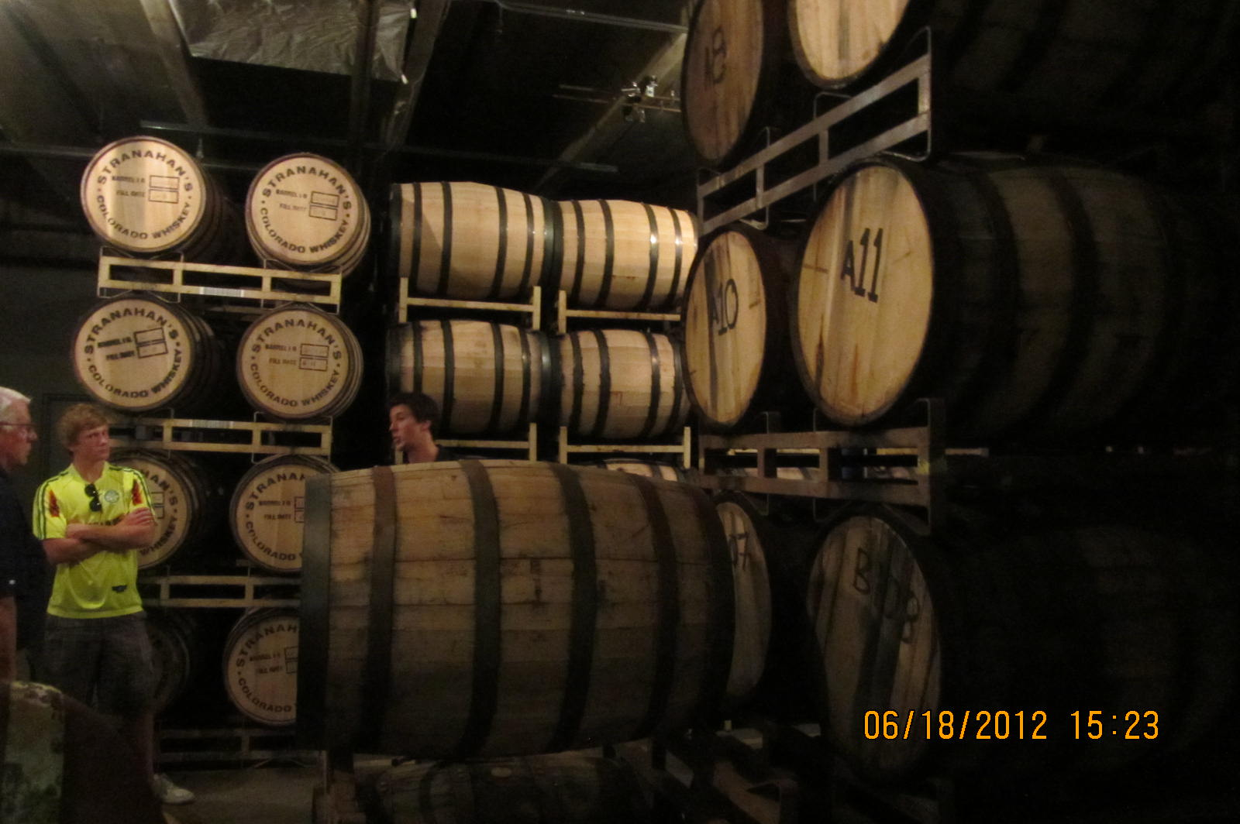
2012-06-18 - At Stranahans Distillery - Denver (8)

Slide 12
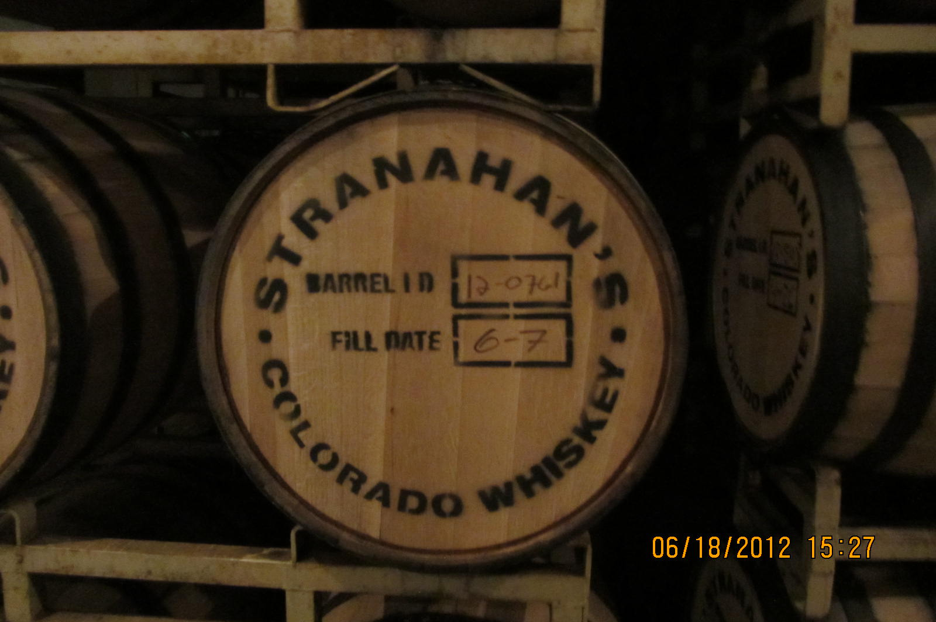
2012-06-18 - At Stranahans Distillery - Denver (9)

Slide 13
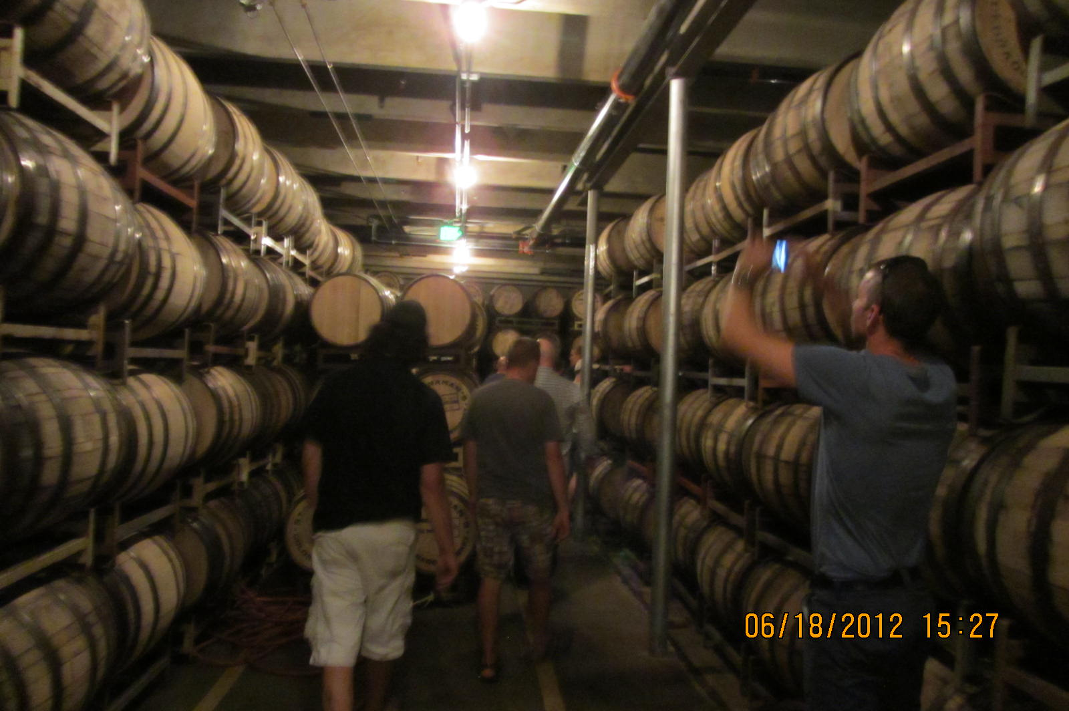
2012-06-18 - At Stranahans Distillery - Denver (10)

